Slide 1

DDos attack detection using ML
Revanth Regeti 16BCE1263
Kartikay Kaul 16BCE1057

Slide 2
Introduction
Using machine learning to detect ddos attack by training the model from the dataset
The dataset imported will be of 5gb and uncompressed as 21gb
The training model will be generated by retrieving appropriate features from the dataset and we will use matlplotlib for data visualization to analyze it and optimize our ML model appropriately

Slide 3
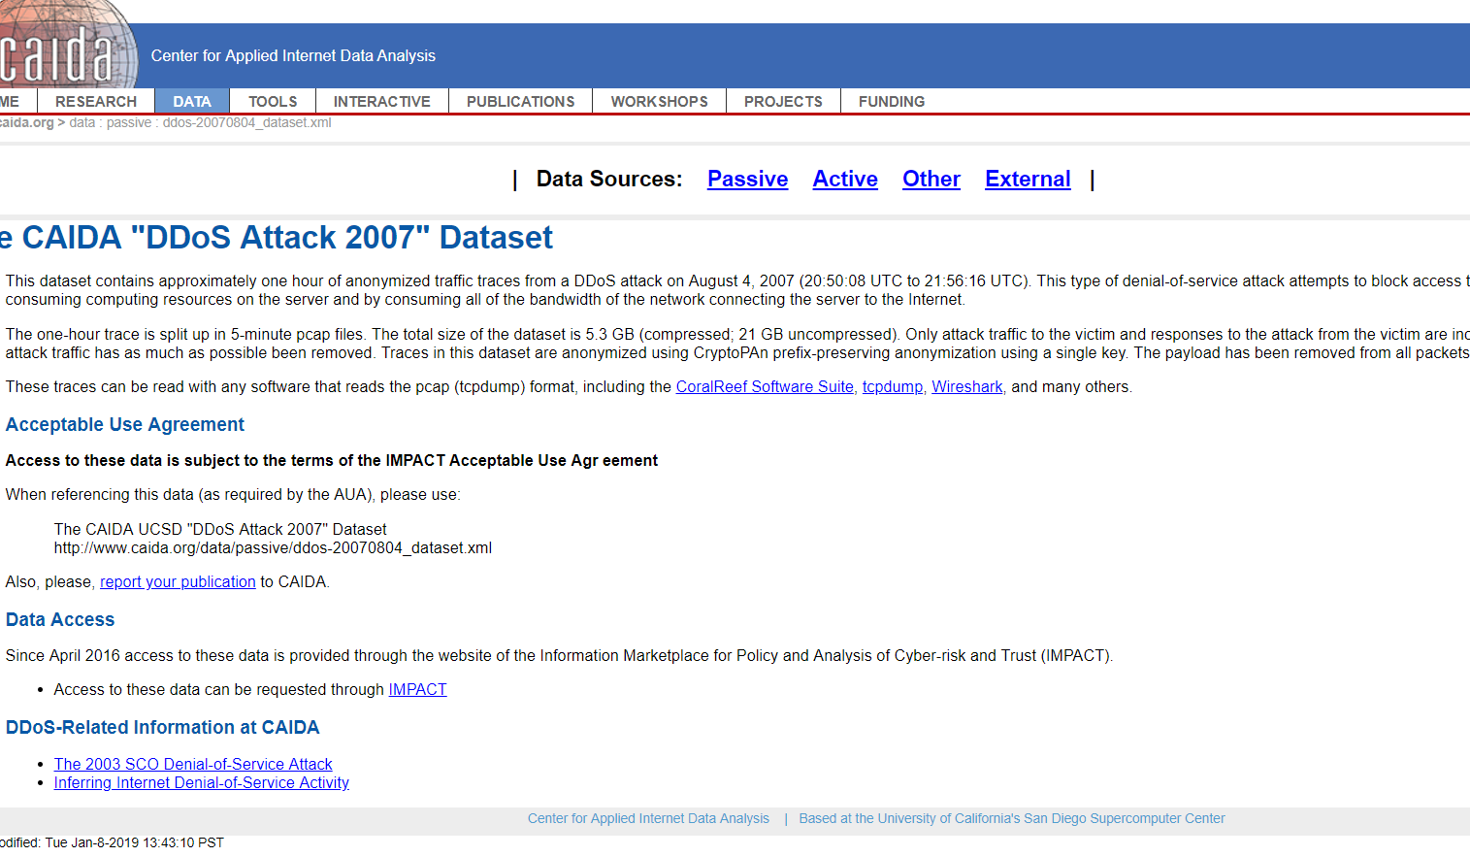
Dataset
CAIDA site’s 2007 dataset will be collected to train our model
It is around 5gb downloadable file

Slide 4
Modules
Two main files will be generated: training and testing
The training model will take the dataset as input and optimize the ML algorithm
The testing file will take the feature value as input and target value will be given as output from the file to the website

Slide 5
Libraries used
Sklearn
Matplotlib
numpy
Pandas
seaborn

Slide 6
Future plan
Maybe we will create a website to enter data and simulate a ddos attack on it in virtual environment

